Slide 1
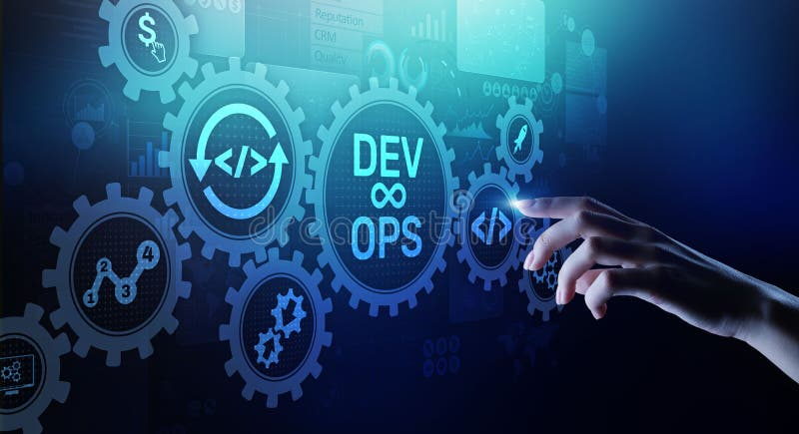
Presented by: Jaden Lee, Faith Jones, Yesenia Caro, and Dante Vega

Slide 2
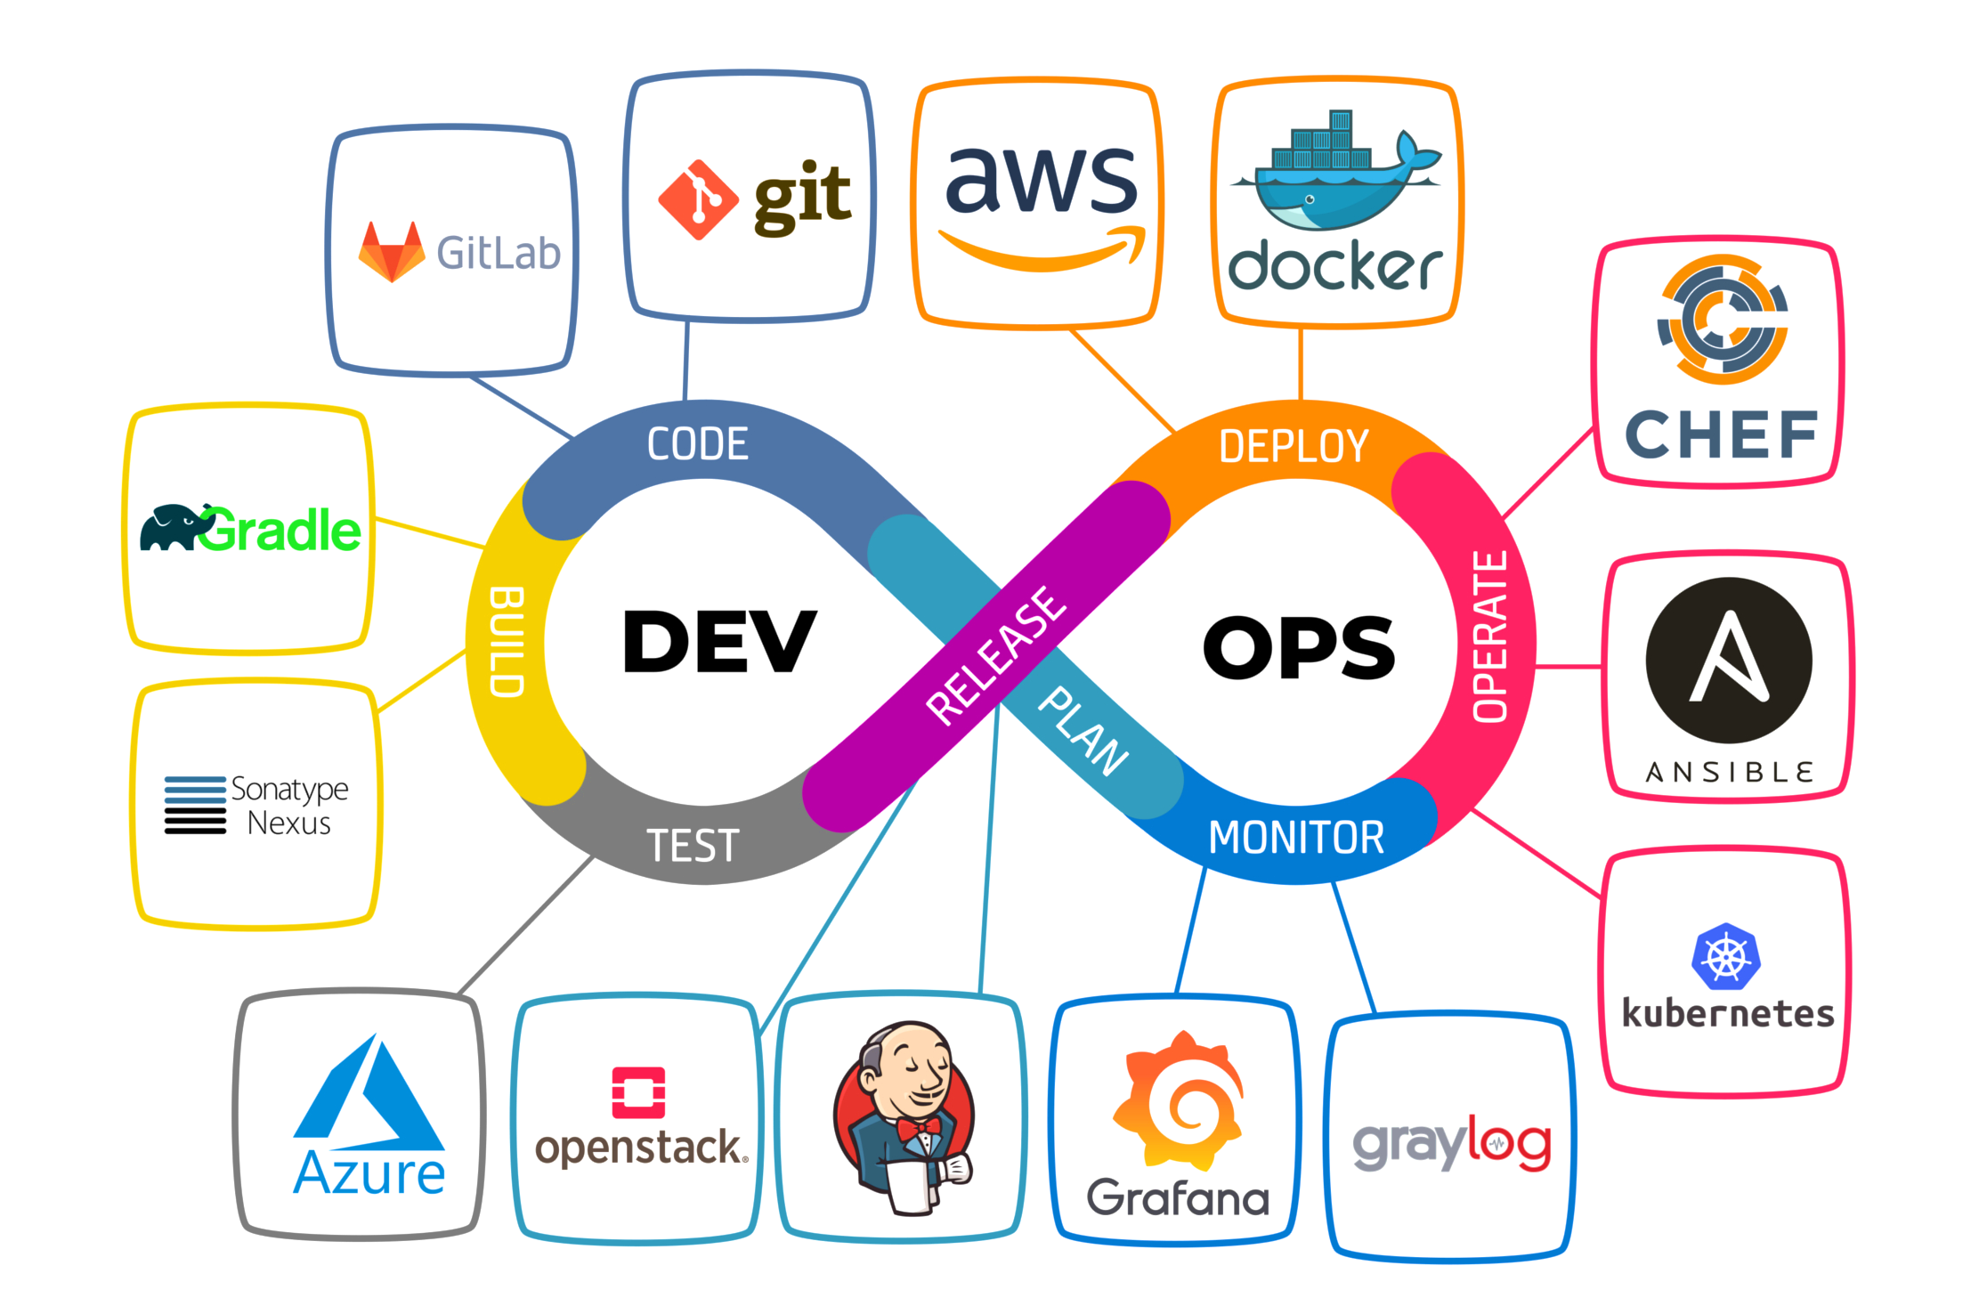
What is DevOps
DevOps is what bridges the gap between the development and operations teams.
Each phase flows into the next and continues forever which is how we end up with Continuous Integration
It allows them both to join as one when sending out new products like services and software’s we used today.
DevOps use several different tools in each individual face whether that is for monitoring or coding to complete the mission's objective

Slide 3
Core Practices and How They Increase Efficiency and Reliability
DevOps: Key Principles & Practices
Unites development and operations for faster, reliable releases
CI/CD: Frequent code integration, automated testing, and rapid deployment
Automated workflows: Builds, tests, quality & security checks, deployment
Infrastructure as Code (IaC): Consistent, repeatable environments
Automated testing enables faster releases and reliable code
Monitoring & logging for quick issue detection and response
Collaboration: Shared responsibility across teams
Smaller, frequent releases reduce risk and speed feedback
Improves efficiency, reliability, and problem-solving

Slide 4

DevOPs on the Cloud
DevOPs helps development and IT operations teams work together to build, test, and release applications faster using cloud automation.
AWS | Microsoft Azure | Google Cloud
CodePipeline CodeBuild CloudWatch | Azure DevOPs Azure Pipeline Azure Monitor | Cloud Build Cloud Display Cloud Monitoring
Why it matters: It helps teams deploy updates faster, reduce mistakes, monitor apps, and scale cloud resources when needed.

Slide 5

Challenges of Implementing DevOps
Successful DevOps adoption requires knowledge of:
Automation, Cloud platforms, CI/CD pipelines which many organizations struggle to find or train engineers with this pallet of skills and knowledge
DevOps often involves many tools such as:
Source control, Build systems, Testing frameworks, Deployment tools and Monitoring platforms
Integrating these tools smoothly can be difficult especially with legacy systems.
Continuous deployment requires strong monitoring systems to detect issues quickly
The cost of process redesigning, training employees, cloud migration and to acquire the new tools as transferring legacy to Modern DevOps workflows can be costly!

Slide 6

Questions?

Slide 7
Thank You

